Slide 1
Abstract #: Abstract Title
Authors:
Background/Methods:
Who cares?
Explain why your study matters in the fastest, most concise way possible (feel free to add graphics/images!)
Conclusions/Main Finding Goes Here in Plain English
Emphasize Important Words
Insert Logos, Acknowledgements, Author Contact Information, QR Codes here
Results/Graphs/Data:
Delete this text and replace with your
Graphs
Charts/Comparisons
Images
Tables
Methods:
How did you find this?
What did you collect and who did you collect it from?
How did you test it?
Illustrate your methods if you can!
Future Directions for Research:
Notes:
Poster Template using Individual Text Boxes

Slide 2
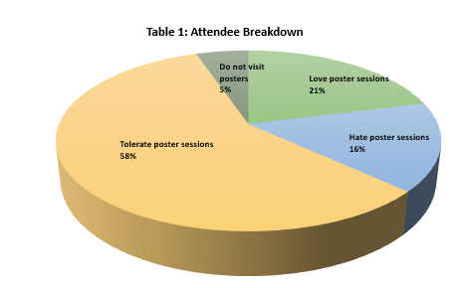
Abstract #: How to Create a Stellar Poster Presentation
Authors: John Doe, Jane Smith, ASCO
Background/Methods:
Use bullet point to create visual space within the text on your poster
Only include what is necessary.
Set the stage for the study.
Focus more on the Results and Conclusions than on Background and Methods.
Your poster is a vehicle for explaining to attendees where the research in the field is going, and why it matters to clinicians.
Emphasize actionable take-home points for optimal attendee learning.
Insert Logos, Acknowledgements, Author Contact Information, QR Codes here
Results/Graphs/Data:
We surveyed meeting attendees and ASCO staff to find out what they loved or hated about poster presentations.
The survey included 5 questions.
90% stated that posters with too much text can be overwhelming.
10% of respondents do not visit the Poster Sessions.
80% appreciate use of tables/charts/graphs to demonstrate findings.
Methods:
This poster was built to serve as a guide for attendees to organize their research for poster presentation.
Why is this study important? Who does this research help?
What questions does this study aim to answer?
Why is it relevant to attendees?
Future Directions for Research:
How does this study help move the field forward/ provide value to clinicians and patients?
Make a better poster! Learn more here:
https://www.insidehighered.com/news/2019/06/24/theres-movement-better-scientific-posters-are-they-really-better
Notes:
Sample

Slide 3
Real World Samples
Notes:
REAL LIFE EXAMPLES

Slide 4
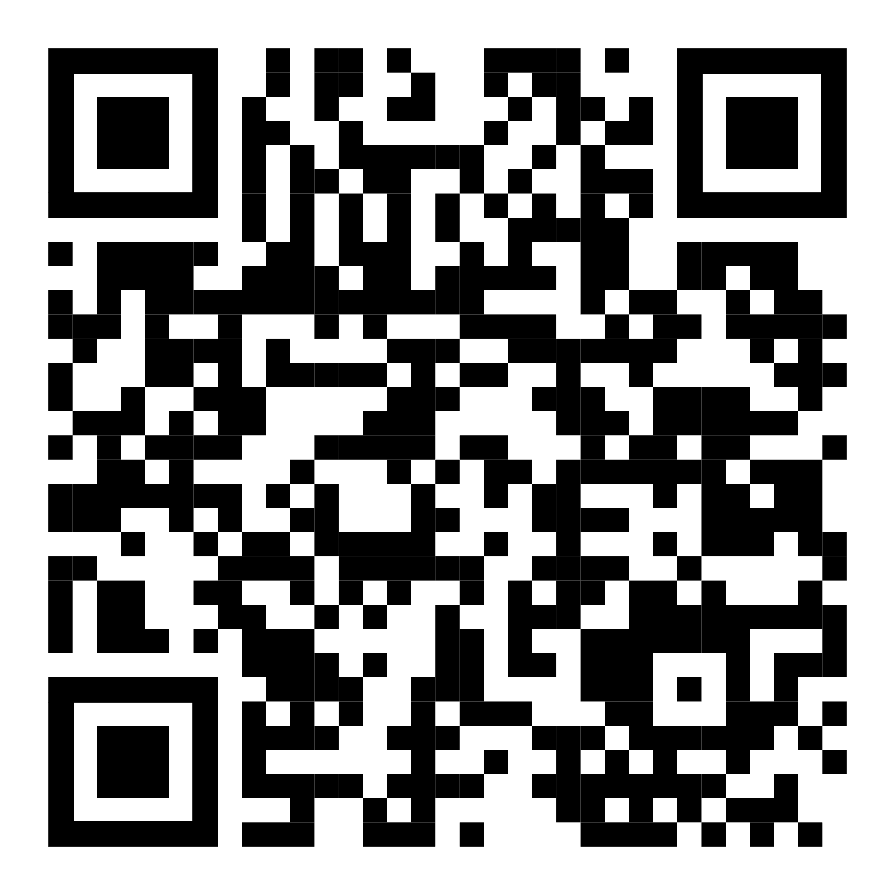
How to QR Code
How do I create a QR code?
https://www.qrcode-monkey.com/ is free, URLs don’t expire, and you can add cool features like images.
How do I scan a QR code?
Just pull out your phone and take a picture! All modern iPhones and most Android phones have built-in QR detection in their cameras. Some Android phones may need an app.
Ctrl-click this thumbnail to watch a video on scanning #betterposter QR codes.
Donated by @kristinrojasmd
https://twitter.com/kristinrojasmd/status/1124418213050298368

Slide 5
Additional Resources
Learn about the development of this Template by Mike Morrison, Michigan State University: https://www.insidehighered.com/news/2019/06/24/theres-movement-better-scientific-posters-are-they-really-better
Watch this YouTube Video explaining the Template: https://www.youtube.com/watch?v=1RwJbhkCA58&feature=youtu.be

